Slide 1
Data Preprocessing
Lecturer: Dr. Bo Yuan
E-mail: yuanb@sz.tsinghua.edu.cn

Slide 2
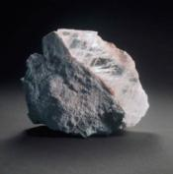
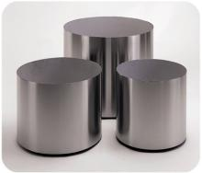
Outline
Data Cleansing
Data Transformation
Data Description
Feature Selection
Feature Extraction

Slide 3
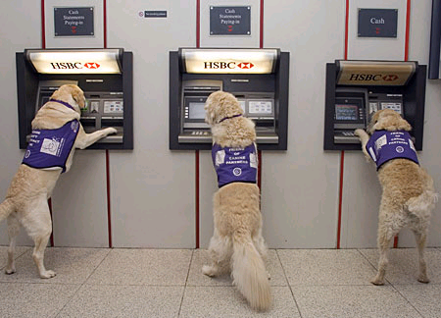

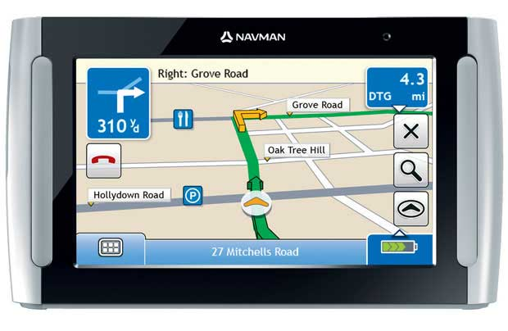

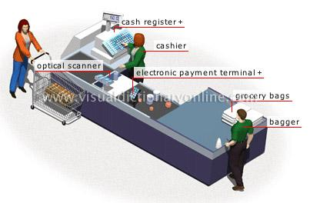
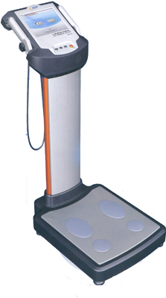
Where are data from?

Slide 4

Why Data Preprocessing?
Real data are notoriously dirty!
The biggest challenge in many data mining projects
Incomplete
Occupancy = “ ”
Noisy
Salary = “-100”
Inconsistent
Age = “42” vs. Birthday = “01/09/1985”
Redundant
Too much data or too many features for analytical analysis
Others
Data types
Imbalanced datasets

Slide 5

Missing Data
Data are not always available.
One or more attributes of a sample may have empty values.
Many data mining algorithms cannot handle missing values directly.
May cause significant troubles.
Possible Reasons
Equipment malfunction
Data not provided
Not Applicable (N/A)
Different Types
Missing completely at random
Missing conditionally at random
Not missing at random

Slide 6

How to handle missing data?
Ignore
Remove samples/attributes with missing values
The easiest and most straightforward way
Work well with low missing rates
Fill in the missing values manually
Recollect the data
Domain knowledge
Tedious/Infeasible
Fill in the missing values automatically
A global constant
The mean or median
Most probable values
More art than science

Slide 7
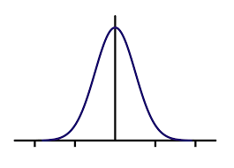
Missing Data: An Example
P(Y|X)
M_Y
Y
M_Y
M_Y
X

Slide 8
Outliers
Outliers
y
y = x + 1
x

Slide 9

Outliers
Outliers

Slide 10
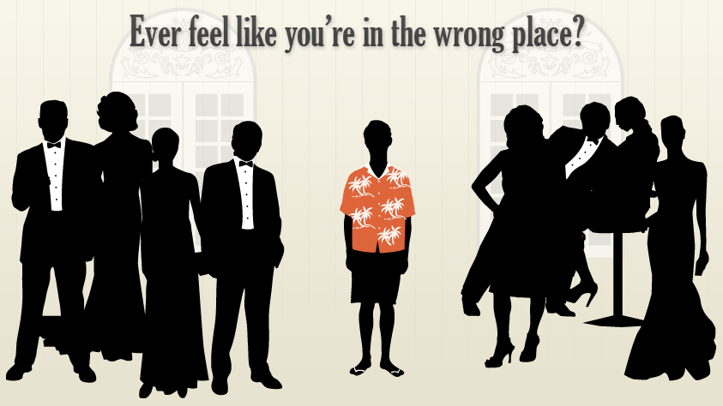
Anomaly vs. Outlier

Slide 11


Slide 12
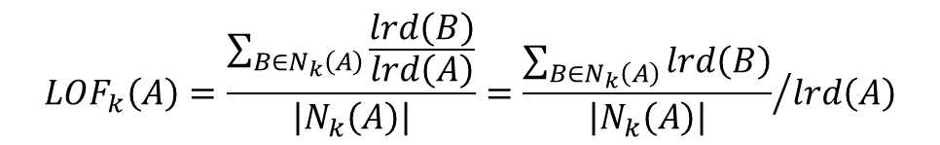
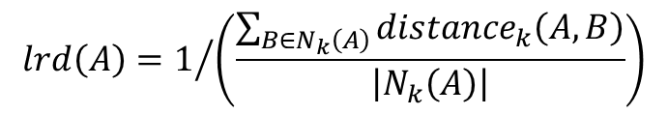
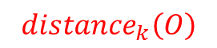
Local Outlier Factor
$${distance}_{k}\left(O\right)$$
k=3
p₂
o
p₁
$${distance}_{k}\left(A,B\right)=max\left\{{distance}_{k}\left(B\right),d\left(A,B\right)\right\}$$
p₃
p₄
$$lrd\left(A\right)=1/{\left(\frac{\sum_{B∈N_{k}\left(A\right)}{{distance}_{k}\left(A,B\right)}}{\left|N_{k}\left(A\right)\right|}\right)}$$
$${LOF}_{k}\left(A\right)=\frac{\sum_{B∈N_{k}\left(A\right)}{\frac{lrd\left(B\right)}{lrd\left(A\right)}}}{\left|N_{k}\left(A\right)\right|}={\frac{\sum_{B∈N_{k}\left(A\right)}{lrd\left(B\right)}}{\left|N_{k}\left(A\right)\right|}}/{lrd\left(A\right)}$$

Slide 13
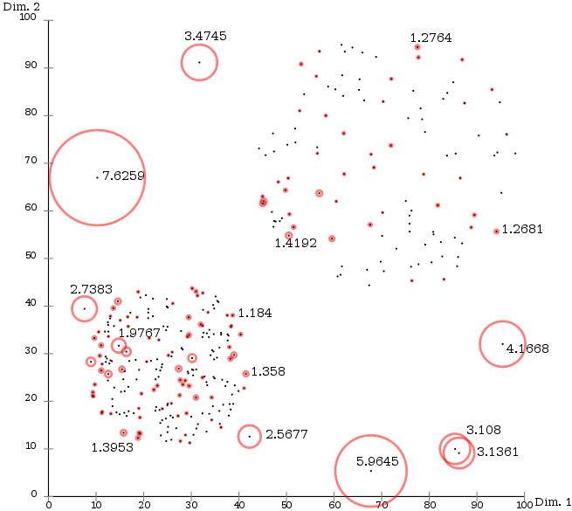
Local Outlier Factor

Slide 14
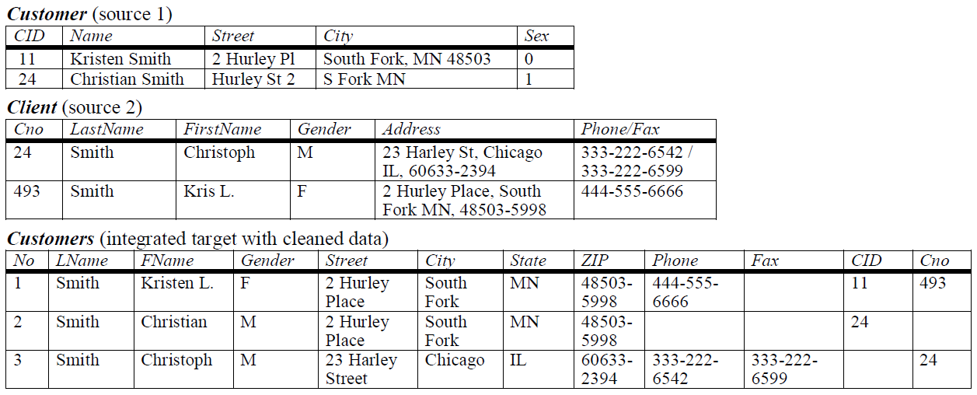
Duplicate Data

Slide 15
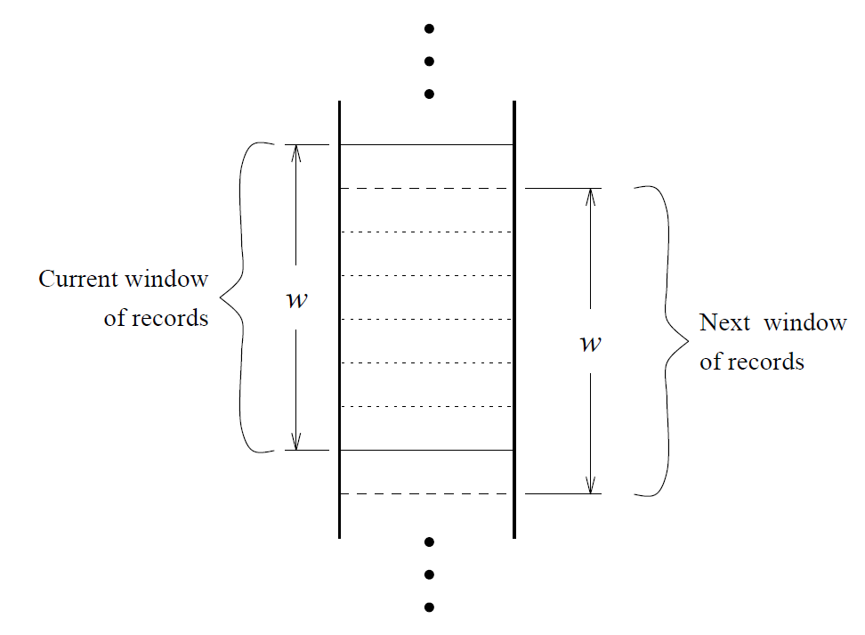
Duplicate Data

Slide 16
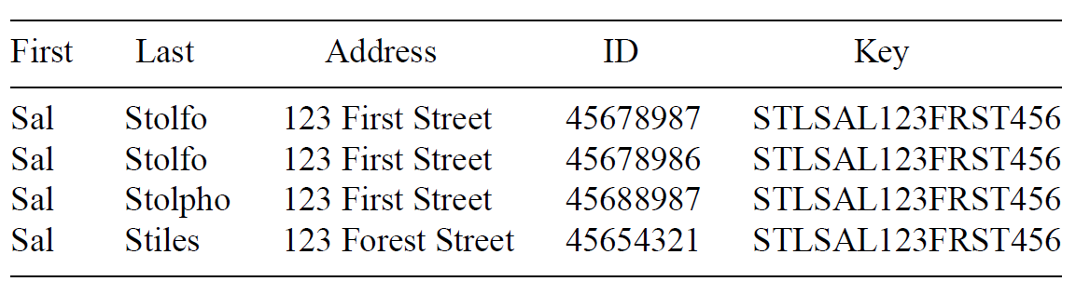
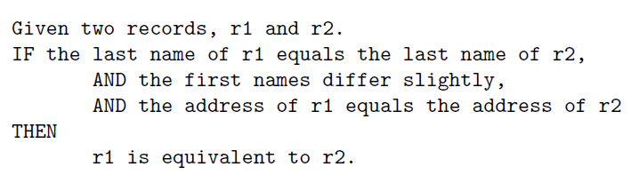
Duplicate Data
Create Keys
Sort
Merge

Slide 18
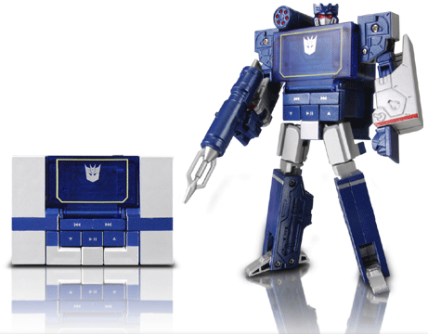
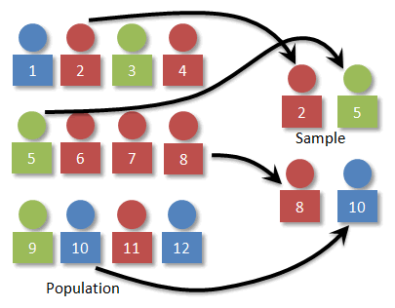
Data Transformation
Now we have an error free dataset.
Still needs to be standardized.
Type Conversion
Normalization
Sampling

Slide 19
Attribute Types
Continuous
Real values: Temperature, Height, Weight …
Discrete
Integer values: Number of people …
Ordinal
Rankings: {Average, Good, Best}, {Low, Medium, High} …
Nominal
Symbols: {Teacher, Worker, Salesman}, {Red, Green, Blue} …
String
Text: “Tsinghua University”, “No. 123, Pingan Avenue” …

Slide 20
Type Conversion
×
○
×
×
○
×
Size
○
×
○
○
×
○
Color

Slide 21
Type Conversion
×
×
○
×
×
○
Size
○
○
×
○
○
×
Color

Slide 22
Type Conversion
0 0 0 1
0 0 1 0
0 1 0 0
1 0 0 0

Slide 23
Sampling
A database/data warehouse may store terabytes of data.
Processing limits: CPU, Memory, I/O …
Sampling is applied to reduce the time complexity.
In statistics, sampling is applied often because obtaining the entire set of data is expensive.
Aggregation
Change of scale:
Cities → States; Days → Months
More stable and less variability
Sampling can be also used to adjust the class distributions.
Imbalanced dataset

Slide 24
Imbalanced Datasets
LHS RHS
10%
5%
85%
Classifier A
Classifier B

Slide 25
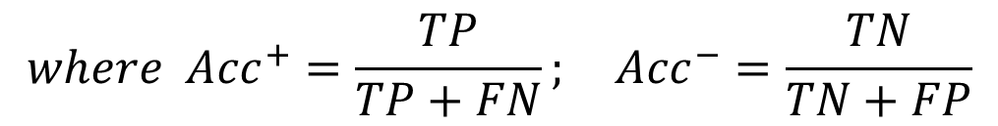
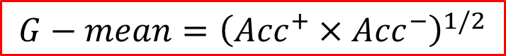
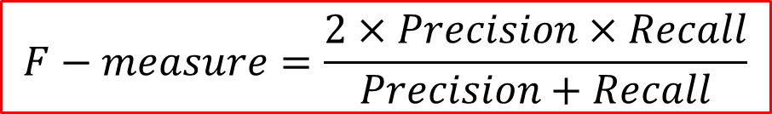
Imbalanced Datasets
$$G−mean={\left({Acc}^{+}×{Acc}^{−}\right)}^{1/2}$$
$$where {Acc}^{+}=\frac{TP}{TP+FN}; {Acc}^{−}=\frac{TN}{TN+FP}$$
$$F−measure=\frac{2×Precision×Recall}{Precision+Recall}$$
$$where Precision=\frac{TP}{TP+FP}; Recall=\frac{TP}{TP+FN}={Acc}^{+}$$

Slide 26
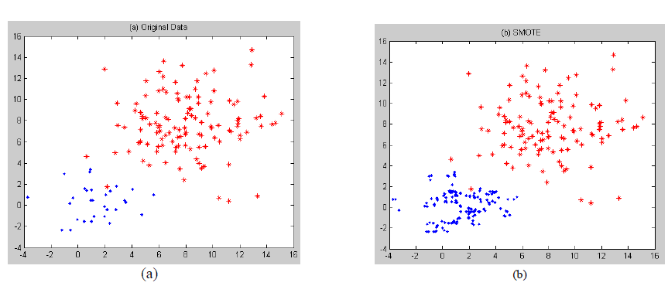
Over-Sampling
SMOTE

Slide 27
Boundary Sampling

Slide 29
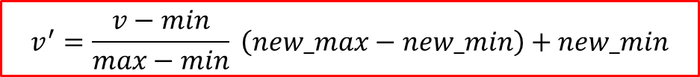
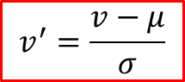
Normalization
The height of someone can be 1.7 or 170 or 1700 …
Min-max normalization:
Let income range $12,000 to $98,000 be normalized to [0.0, 1.0]. Then $73,600 is mapped to
Z-score normalization (μ: mean, σ: standard deviation):
Let μ = 54,000, σ = 16,000. Then
$$v^{′}=\frac{v−min}{max−min} \left(new_max−new_min\right)+new_min$$
$$v^{′}=\frac{v−μ}{σ}$$

Slide 30
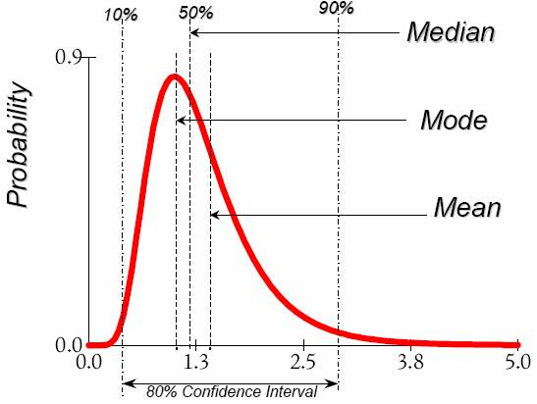
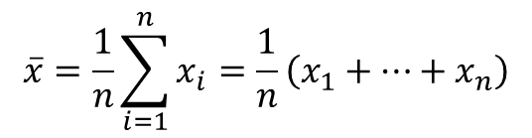
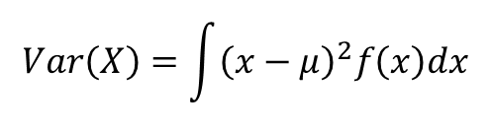
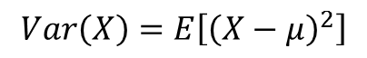
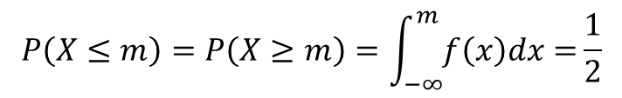
Data Description
Mean
Arithmetic mean
Median
Mode
The most frequently occurring value in a list
Can be used with non-numerical data.
Variance
Degree of diversity
$$\overline{x}=\frac{1}{n}\sum_{i=1}^{n}{x_{i}}=\frac{1}{n}\left(x_{1}+…+x_{n}\right)$$
$$P\left(X≤m\right)=P\left(X≥m\right)=\int_{−∞}^{m}{f\left(x\right)dx=}\frac{1}{2}$$
$$Var\left(X\right)=\int{{\left(x−μ\right)}^{2}f\left(x\right)dx}$$
$$Var\left(X\right)=E\left[{\left(X−μ\right)}^{2}\right]$$

Slide 31
Data Description
Pearson’s product moment correlation coefficient
If r_{A, B} > 0, A and B are positively correlated.
If r_{A, B} = 0, no linear correlation between A and B.
If r_{A, B} < 0, A and B are negatively correlated.

Slide 32
Data Description
Pearson's chi-square (χ²) test
 | Play chess | Not play chess | Sum (row)
Like science fiction | 250 (90) | 200 (360) | 450
Not like science fiction | 50 (210) | 1000 (840) | 1050
Sum (col.) | 300 | 1200 | 1500

Slide 33
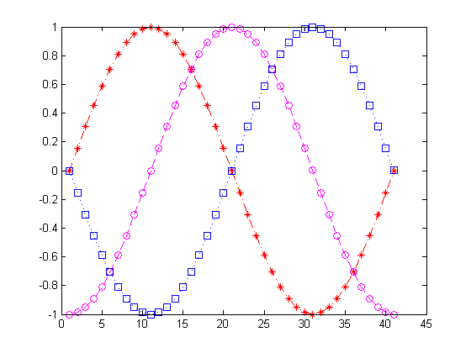
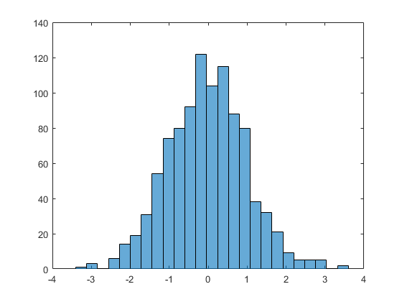
Data Visualization (1D)

Slide 34
Data Visualization (2D)
Notes:
load carsmall
plot(Displacement, Acceleration,'ro')
regress(Acceleration,[ones(100,1),Displacement])
hold on
line([0,19.35/0.021],[19.35,0])

Slide 35
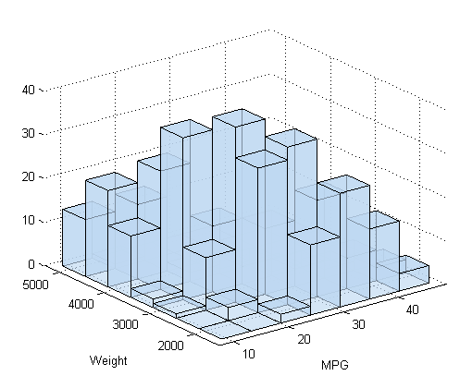
Surf Plots (3D)
Notes:
[X,Y]=meshgrid(-3:0.1:3,-3:0.1:3);
Z=peaks(X,Y);
surfc(X,Y,Z);
shading interp
colormap(gray);

Slide 36
Box Plots (High Dimensional)
Notes:
S=diag([1,2,0.5,1])
M=[0,1,3,-1];
Z=mvnrnd(M,S,10000);
boxplot(Z);

Slide 37
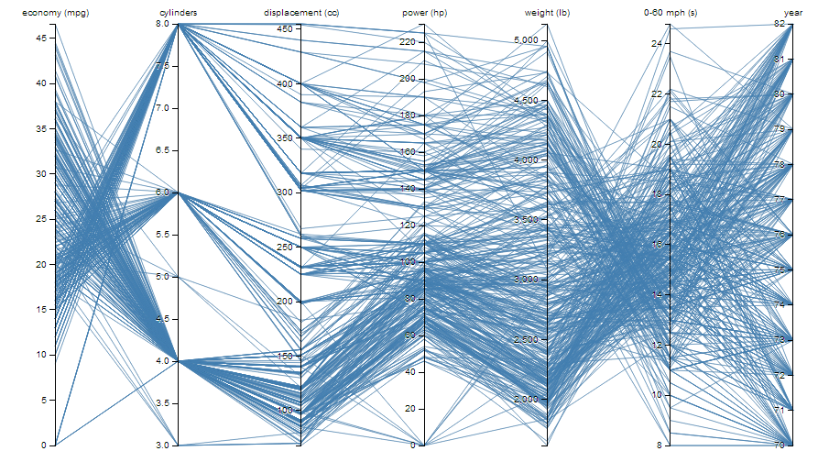
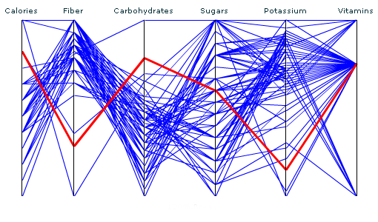
Parallel Coordinates (High Dimensional)

Slide 38
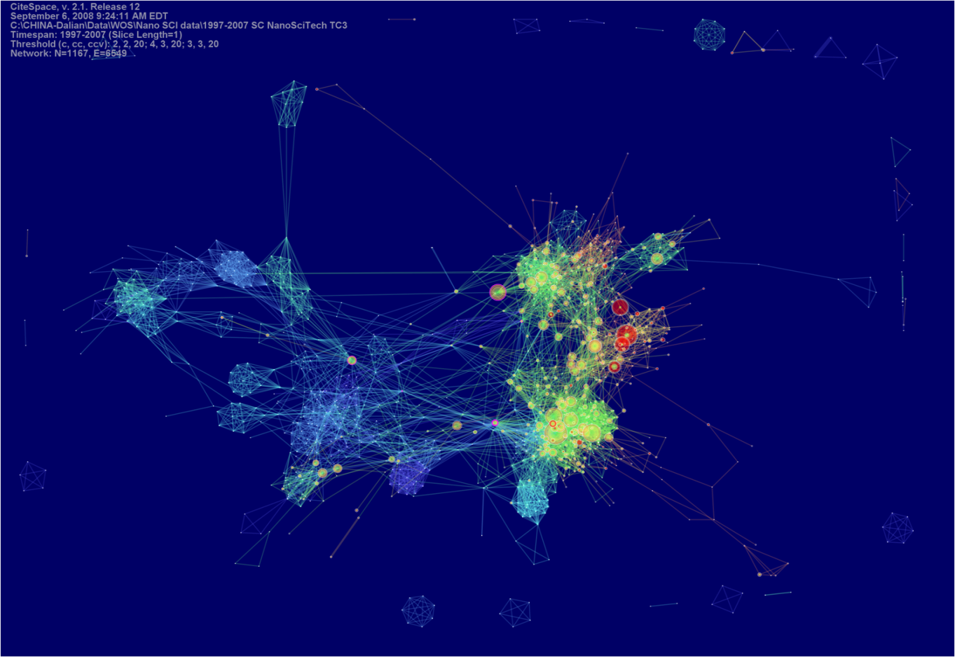
CiteSpace

Slide 39
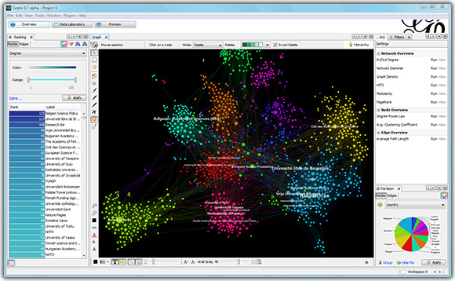
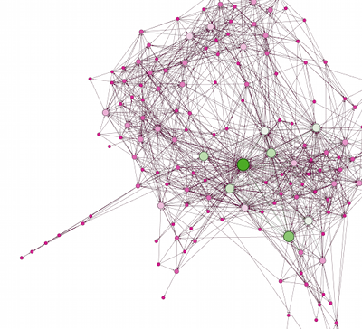
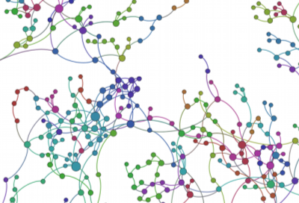
Gephi

Slide 41
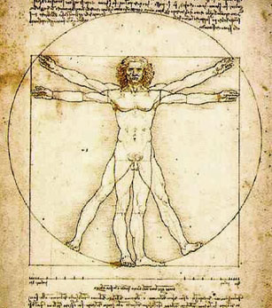
Feature Selection
ID
Weight
Age
Noisy?
Gender
Height
Irrelevant?
Education
Duplicate?
Income
Address
Complexity?
Location
Occupation

Slide 42
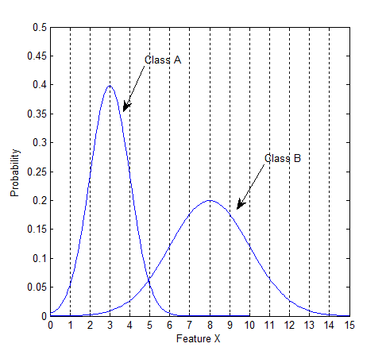
Class Distributions

Slide 43
Class Distributions

Slide 44
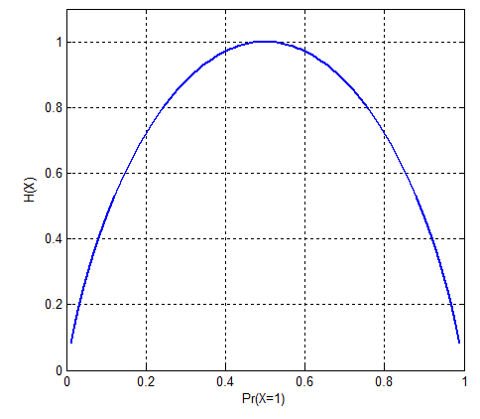
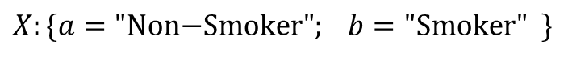
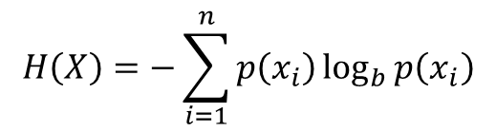
Entropy
$$H\left(X\right)=−\sum_{i=1}^{n}{p\left(x_{i}\right)\log_{b}{p\left(x_{i}\right)}}$$
$$X:\{a="\text{Non}\text{−}\text{Smoker}"; b=\text{"}\text{Smoker}" \}$$
Information Gain
Notes:
a: Non-Smoker (60%) 80% Female 20% Male
b: Smoker (40%) 5% Female 95% Male

Slide 45
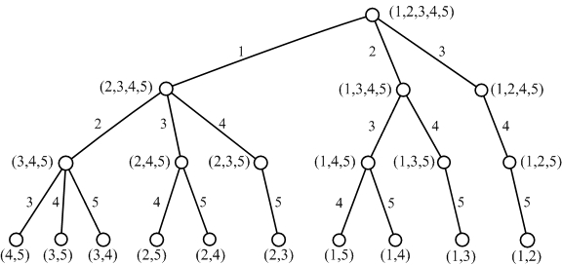
Feature Subset Search
Exhaustive
All possible combinations
Branch and Bound

Slide 46

Feature Subset Search
Top K Individual Features
Sequential Forward Selection
Sequential Backward Selection
Optimization Algorithms
Simulated Annealing
Tabu Search
Genetic Algorithms

Slide 48

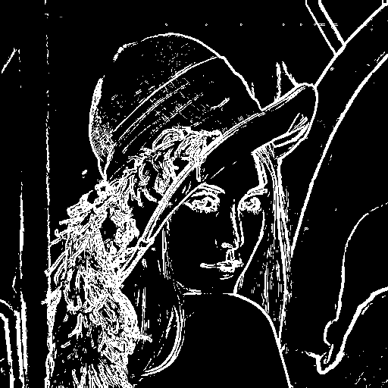
Feature Extraction

Slide 49

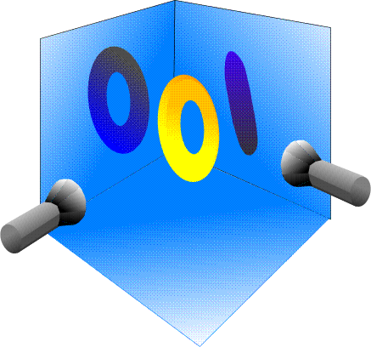
Principal Component Analysis

Slide 50
2D Example
Data: Gaussian Distribution
Variance: Information
Ellipse: Major Axis vs. Minor Axis
Select the attribute corresponding to the Major Axis.
Minor
Major
Feature X₂
Feature X₁

Slide 51
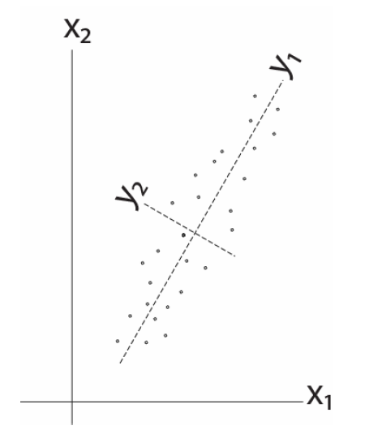
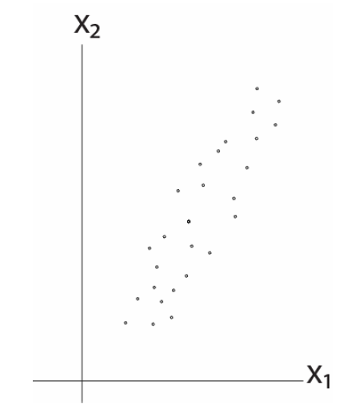
2D Example

Slide 52
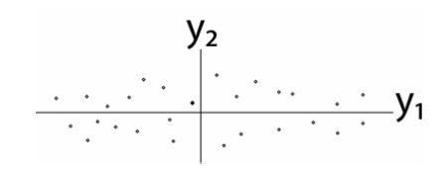
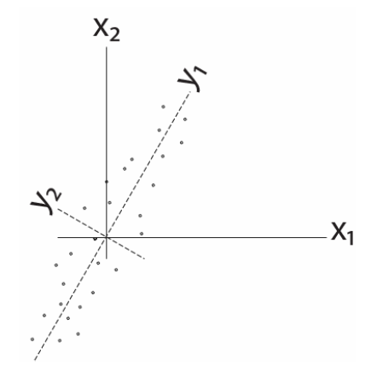


2D Example
Remove correlation

Slide 53






Some Math
Goal: S(Y) has nonzero diagonal entries and all off-diagonal elements are zero.
Eigendecomposition

Slide 54












A Different View
$$x_{k}$$
e
$$J\left(e\right)=\sum_{i=1}^{n}{{\left\|{x_{k}^{}}^{′}−x_{k}\right\|}^{2}}$$
$$α_{k}=e^{t}x_{k}$$
$${x_{k}^{}}^{′}$$
$$\left\|e\right\|=1$$
$$=\sum_{i=1}^{n}{{\left\|α_{k}e−x_{k}\right\|}^{2}}$$
$$α_{k}$$
$$=\sum_{i=1}^{n}{{α_{k}}^{2}{\left\|e\right\|}^{2}}−2\sum_{i=1}^{n}{α_{k}e^{t}x_{k}}+\sum_{i=1}^{n}{{\left\|x_{k}\right\|}^{2}}$$
$$=−\sum_{i=1}^{n}{{α_{k}}^{2}}+\sum_{i=1}^{n}{{\left\|x_{k}\right\|}^{2}}$$
$$\max_{e}{e^{t}Se s.t. \left\|e\right\|=1}$$
$$=−\sum_{i=1}^{n}{e^{t}x_{k}{x_{k}^{}}^{t}e}+\sum_{i=1}^{n}{{\left\|x_{k}\right\|}^{2}}$$
$$S=\sum_{i=1}^{n}{x_{k}{x_{k}^{}}^{t}}$$

Slide 55


Lagrange Multipliers

Slide 56



More Math ...
eigenvector
eigenvalue
PCA
To project the original data to the eigenvectors of S with the largest eigenvalues.
$$\left[\begin{matrix}2 & 1 \\ 1 & 2\end{matrix}\right]\left[\begin{matrix}1 \\ 1\end{matrix}\right]=\left[\begin{matrix}3 \\ 3\end{matrix}\right]=3\left[\begin{matrix}1 \\ 1\end{matrix}\right]$$
$$\left[\begin{matrix}2 & 1 \\ 1 & 2\end{matrix}\right]\left[\begin{matrix}1 \\ −1\end{matrix}\right]=\left[\begin{matrix}1 \\ −1\end{matrix}\right]$$

Slide 57


PCA Examples

Slide 58





Fish

Slide 59


Fish

Slide 61

The Issue of PCA
Now, let’s consider class information ...

Slide 62

Linear Discriminant Analysis
The objective of LDA is to perform dimension reduction while preserving as much of the class discriminatory information as possible.
Given a set of d-D vectors x₁, x₂, ..., x_{n} of which N₁ belong to ω₁, and N₂ to ω₂. Of all the possible projection lines y=w^{T}x, find the one that maximizes the separability.

Slide 63


Measure of Separability

Slide 64


Fisher Criterion
Maximize the distance between classes
Minimize the scatter within each class

Slide 65






Some Math …
between-class scatter
within-class scatter

Slide 66


More Math...
generalized Rayleigh quotient

Slide 67


More Math...
eigenvector problem!
scalar

Slide 69

LDA Example
Dataset
$C1=\left[\left(1,2\right);\left(2,3\right);\left(3,3\right);\left(4,5\right);(5,5)\right]$
$C2=\left[\left(1,0\right);\left(2,1\right);\left(3,1\right);\left(3,2\right);\left(5,3\right);(6,5)\right]$
Covariance of [c1; c2]
$Z=\left[\begin{matrix}2.7636 & 2.2545 \\ 2.2545 & 3.0182\end{matrix}\right]$
Eigenvectors and Eigenvalues of Z
$V=\left[\begin{matrix}−0.7268 & 0.6869 \\ 0.6869 & 0.7268\end{matrix}\right]$
$D=\left[\begin{matrix}0.6328 & 0 \\ 0 & 5.1490\end{matrix}\right]$
The direction of PCA projection: ${\left[0.6869, 0.7268\right]}^{T}$

Slide 70

LDA Example
The mean of each class
$μ_{1}=mean\left(c1\right)={\left[3.0, 3.6\right]}^{T}$
$μ_{2}=mean\left(c2\right)={\left[3.3, 2.0\right]}^{T}$
$S_{B}={\left(μ_{1}−μ_{2}\right)\left(μ_{1}−μ_{2}\right)}^{T}$=$\left[\begin{matrix} 0.11 & −0.53 \\ −0.53 & 2.56\end{matrix}\right]$
The scatter of each class
$S_{1}=4×cov\left(c1\right)=\left[\begin{matrix}10 & 8 \\ 8 & 7.2\end{matrix}\right]$
$S_{2}=5×cov\left(c2\right)=\left[\begin{matrix}17.3 & 16 \\ 16 & 16\end{matrix}\right]$
$S_{w}=S_{1}+S_{2}=\left[\begin{matrix}27.3 & 24 \\ 24 & 23.2\end{matrix}\right]$

Slide 71

LDA Example
${S_{w}}^{−1}S_{B}=\left[\begin{matrix}0.26 & −1.27 \\ −0.30 & 1.42\end{matrix}\right]$
Eigenvectors and Eigenvalues of ${S_{w}}^{−1}S_{B}$
$V=\left[\begin{matrix}−0.98 & 0.67 \\ −0.20 & −0.75\end{matrix}\right]$
$D=\left[\begin{matrix}0 & 0 \\ 0 & 1.69\end{matrix}\right]$
The direction of LDA projection: ${\left[0.6656, −0.7463\right]}^{T}$
Alternatively
${S_{w}}^{−1}{\left(μ_{1}−μ_{2}\right)}^{T}={\left[−0.7936, 0.8899\right]}^{T}$
After normalization: ${\left[−0.6656, 0.7463\right]}^{T}$

Slide 72
LDA Example

Slide 73

C-Class LDA

Slide 74

C-Class LDA
For C-class LDA with C=2, S_{B} is defined as:

Slide 75
C-Class LDA
N1=1000; N2=500; N3=2000;
X1=mvnrnd([0,0], [1,0;0,1], N1);
X2=mvnrnd([3,6], [1,-0.8;-0.8,1], N2);
X3=mvnrnd([10,6], [1,0.8;0.8,1], N3);
S1=(N1-1)*cov(X1); S2=(N2-1)*cov(X2); S3=(N3-1)*cov(X3);
Sw=S1+S2+S3;
M1=mean(X1); M2=mean(X2); M3=mean(X3);
Mu=(N1*M1+N2*M2+N3*M3)/(N1+N2+N3);
Sb=N1*(M1-Mu)'*(M1-Mu)+N2*(M2-Mu)'*(M2-Mu) +N3*(M3-Mu)'*(M3-Mu);
J=inv(Sw)*Sb; [V,D]=eig(J);

Slide 76




Limitations of LDA
LDA produces at most C-1 projections
S_{B} is a matrix with rank C-1 or less.
S_{W} may be singular.
LDA does not work well when ...

Slide 77
Reading Materials
M. A. Hernandez and S. J. Stolfo, “Real-World Data is Dirty: Data Cleansing and The Merge/Purge Problem,” Data Mining and Knowledge Discovery, vol. 2, pp. 9–37, 1998.
A. Donders, G. van der Heijden, T. Stijnen, and K. Moons, “Review: A Gentle Introduction to Imputation of Missing Values,” Journal of Clinical Epidemiology, vol. 59, pp. 1087-1091, 2006.
N. V. Chawla, K. W. Bowyer, L. O. Hall and W. P. Kegelmeyer, “SMOTE: Synthetic Minority Over-Sampling Technique,” Journal of Artificial Intelligence Research, vol. 16, pp. 321–357, 2002.
N. Japkowicz and S. Stephen, “The Class Imbalance Problem: A Systematic Study,” Intelligent Data Analysis, vol. 6, pp. 429–449, 2002.
D. Keim, “Information Visualization and Visual Data Mining,” IEEE Transactions on Visualization and Computer Graphics, vol. 8, pp. 1-8, 2002.
PCA Tutorials
http://www.cs.princeton.edu/picasso/mats/PCA-Tutorial-Intuition_jp.pdf
http://www.cs.otago.ac.nz/cosc453/student_tutorials/principal_components.pdf
Lagrange Multipliers
http://diglib.stanford.edu:8091/~klein/lagrange-multipliers.pdf

